Slide 1
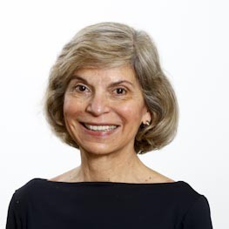
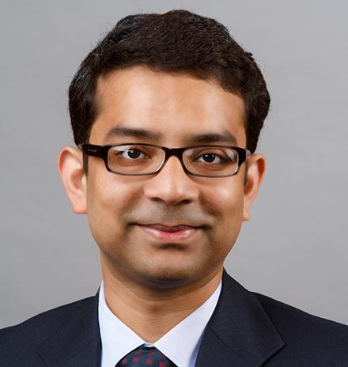
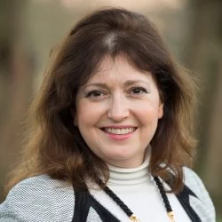
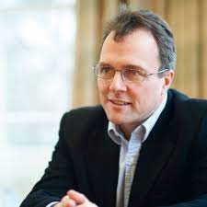
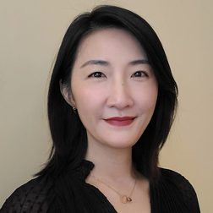
Digital Globalization Research Summit
Wednesday, February 21st 11:00 – 12:30 PM
Room 1118, 55 Park St, Atlanta
GSU Robinson College of Business
Maria Tereza Fleury
Raj Chaudhury
Annabelle Gawer
Julian Birkinshaw
Cecilia Gu
Past President, AIB
HBS
Univ of Surrey
London Business School
GSU Robinson
RSVP NOW
An exciting opportunity to meet your colleagues at home and abroad!
Lunch and Discussion follows the Simulcast 1230-2:00 pm.
Summit Details

